Slide 1
Notes:
Talk to Miguel about changing slide cover – Add in unique slide cover for learning agenda

Slide 2
FEDERATION FOR INNOVATION IN DEMOCRACY – NORTH AMERICA
Our Learning Agenda & Independent Evaluations
Yukon Citizens’ Assembly on Electoral Reform (Case Study 1)
Dr. Marjan H. Ehsassi

Slide 3
Why a Learning Agenda?
While Citizens' Assemblies have been extensively researched, this work has not been done in a comprehensive manner, resulting in inconsistent and incomplete data.
According to the OECD Deliberative Wave study:
67% of practitioners report conducting evaluations themselves
A GAP:
The need to develop a consistent and methodology methodology and practice for Independent and Comparative Assessments across CAs
Source: OECD, Catching the Deliberative Wave, 2020

Slide 4
What is FIDE – North America’s Learning Agenda?
We define our Learning Agenda as an independent framework that allows us to evaluate design and implementation decisions and the impact of Citizens’ Assemblies across North America.
Through our Learning Agenda, we seek to answer questions that will increase impact and strengthen citizens’ assemblies.
We collect, analyze and share evidence-based data and case studies that demonstrate the areas of strength and areas in need of improvement of Citizens’ Assemblies in North A
We implement this agenda through FIDE - North America's multi-methods approach which includes surveys, researcher observations and in-depth interviews.
Independent Evaluations & Case Studies
Notes:
Finally: We hold ourselves accountable – How will we measure our success

Slide 5
Our Objectives
Collaborate with local Citizens’ Assemblies (CAs) across North America to build an evidence-based understanding of design and implementation decisions and the impact of Citizens’ Assemblies.
2. Collect and share comparative data with communities of practice: implementers, researchers, government officials and staff and donors. This will allow us to tell the stories of Citizens’ Assemblies through robust case studies.
3. Use data and analysis to expand recognition, strengthen the impact, and promote learning of Citizens’ Assemblies across North America.
Notes:
Conversations are increasing …

Slide 6
Developed by the OECD

Slide 7
Our Multi-Methods Approach
Baseline & Endline Survey
In-Depth Interviews
Researcher Observations
Surveys are designed to evaluate:
Process Design and Implementation Design (ie. Recruitment; Curation of evidence and learning; and Deliberation and Proposal Writing)
II. Changes in Participant Beliefs and Attitudes (ie. Activated Citizenship; Sense of Community and Belonging; Opinion Shift; Polarization)
III. Government Presence, Promise, Policy Impact and Accountability
IV. Trust and Future of Citizens’ Assemblies
Our Lead Evaluator attends and observes at least one full session. This allows for independent and neutral assessment of the process.
The Lead Evaluator also conducts desk research prior to the assembly to gain understanding on history and the politics of the location and the context of the assembly.
To the extent possible, we welcome opportunities for the Lead Evaluator to attend implementer strategy meetings and briefings.
At the conclusion of a CA, we conduct between 8-12 in-depth interviews. These provide for additional qualitative data from:
participants,
implementers
Facilitators; and,
elected representatives and/or public manager

Slide 8
Deliverables
Case Study
A published case study on each Citizens’ Assembly covering design and implementation decisions, impact on participants, changes in behavior and attitudes, government accountability, legitimacy of process and policy impact.
Slide deck
A slide deck highlighting the data, the findings and the observations from the case study.
Raw Data
Evidence collected from the surveys
Notes:
WHILE THE DEMOCRATIC PRINCIPLE CONTINUES TO INSPIRE AND ASPIRE
Expand the definition of citizen engagement

Slide 9
Moving Forward
1.CURRENT: Yukon Citizens’ Assembly on Electoral Reform
May to September 2024
Initial Data available mid-late September
Data analysis in progress and deliverables expected to be finalized by October 2024
2024/2025: FIDE NA will be working on the following Independent Evaluations
2. Victoria & Saanich Citizens’ Assembly, BC
3. Millcreek, Utah
4. Boulder, Colorado
5. Ramallah, West Bank
Notes:
Conversations are increasing …

Slide 10
Case Study 1 FIDE - North America’s Independent Evaluation of the Yukon Citizens’ Assembly on Electoral Reform
October 2024
Mary Hurner

Slide 11
Background on the Yukon Citizens’ Assembly
Recruitment
Participants were randomly selected from a pool of 1,793 Yukoners who had been previously surveyed and indicated their interest in participating in a Citizens’ Assembly
Recruitment Criteria
Electoral District
Gender
Age
Indigenous Ancestry
Sessions
The Citizens’ Assembly was held over 4 weekend sessions (8 full days)
Between May – September of 2024
Mandate
The YCA shall examine electoral systems and issue a report recommending whether the current model used for electing Members of the Yukon Legislative Assembly should be retained or another model should be adopted

Slide 12
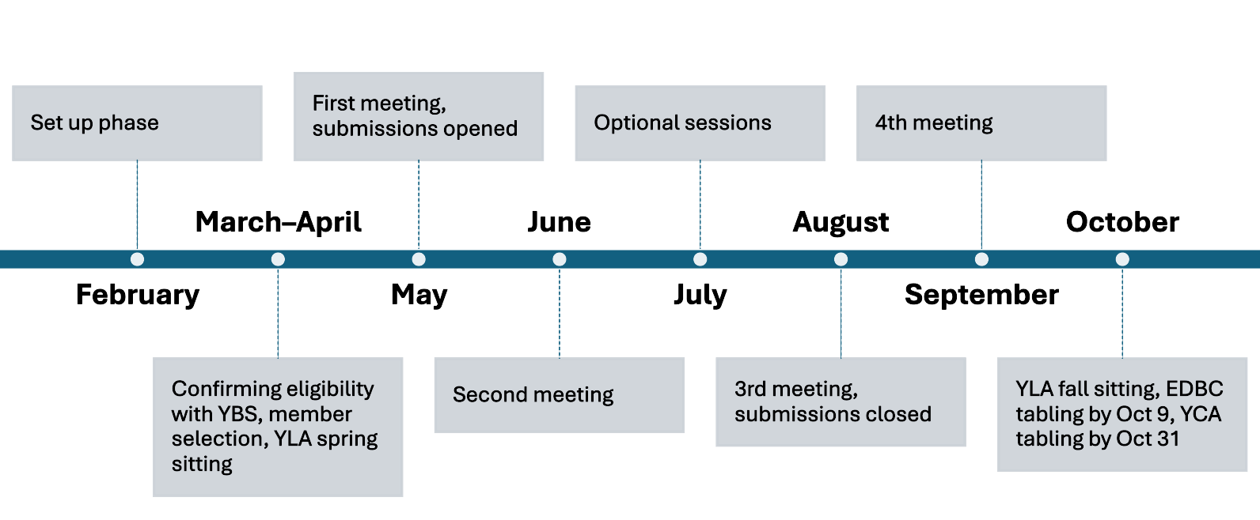
Timeline of the Yukon Citizens’ Assembly
Timeline provided by the Yukon Citizens’ Assembly

Slide 13
Presence of Yukon Government Officials
To see the [citizens’ in the room] look at each other with such respect was an immense privilege to watch. For me it cemented everything. Individuals given the task of learning hard things and making recommendations really can do it.
- Yukon Elected Official on receiving the recommendations of the Citizens’ Assembly
The Premier of the Yukon and 2 members of the Yukon Legislative Assembly made opening remarks at the opening session of the Yukon Citizens’ Assembly.
During the Learning Phase, a few members of the Legislative Assembly presented to the participants on the role and duties of elected officials.
Government representatives did not observe the work of the CA throughout the assembly.
The two MLAs returned to receive the recommendations from the Citizens’ Assembly during the final session. They made a commitment to take the recommendations back to caucus for consideration. The Yukon Legislative Assembly is currently considering an electoral reform plebiscite.

Slide 14
Findings from Independent Evaluation
1 – Sense of Community and Belonging
74% of survey respondents answered that a sense of community “very much” emerged throughout the assembly
The remaining 24% of respondents replied that a sense of community “sort of” emerged
Survey Response Rate: 86% (33/38 participants)
By the third session, it was like walking into a room of friends. And, you really didn’t expect that at the first session. (Yukon Citizens’ Assembly Participant Interview)

Slide 15
Findings from Independent Evaluation:
2 - Polarization and Division
Polarization and Division
76% of survey respondents replied that the Citizens’ Assembly on Electoral Reform reduced polarization and division in their community
Survey Response Rate: 86% (33/38 participants)
Change in Opinion
67% of survey respondents reported that their opinion on electoral reform issues changed throughout the Citizens’ Assembly
We had wildly different political views in that room. I found it encouraging that polarization could be so easily overcome in a group like that…. We showed that people can come together and can come up with some great work (Yukon Citizens’ Assembly Participant Interview)

Slide 16
Findings from Independent Evaluation:
3 - Level of Trust in Government
Survey Response Rate: 86% (33/38 participants)
Level of Trust in Government
Pre-Survey - 36% of survey respondents replied that they had a high level of trust in government.
Final Survey - 63% of survey respondents answered that they had a high level of trust in government.
76% of survey respondents reported that if implemented well, citizens’ assemblies can impact societal trust in government
My trust has increased. I like that the government gave the impression that they want to hear what I have to say (Yukon Citizens’ Assembly Participant Interview)

Slide 17
3 QUERIES
Are Independent Evaluations Important and, if so, why? What are some of the principles that would guide your work?
2. What should we measure and what metrics should we use?
3. What are some of the limitations of our methodology? How can we improve on this work?
Notes:
Conversations are increasing …

Slide 18
contact
—— Us
Email: marjan@fidemocracy.org
Website: fide.eu/north-america

