Slide 1
National Civic League
Census Solutions Workshop

Slide 2
Ideation Workshop
Facilitator:
Haley Ashcom
Intergovernmental Affairs Specialist and
Intergovernmental Partnership Account Manager
U.S. Census Bureau

Slide 3
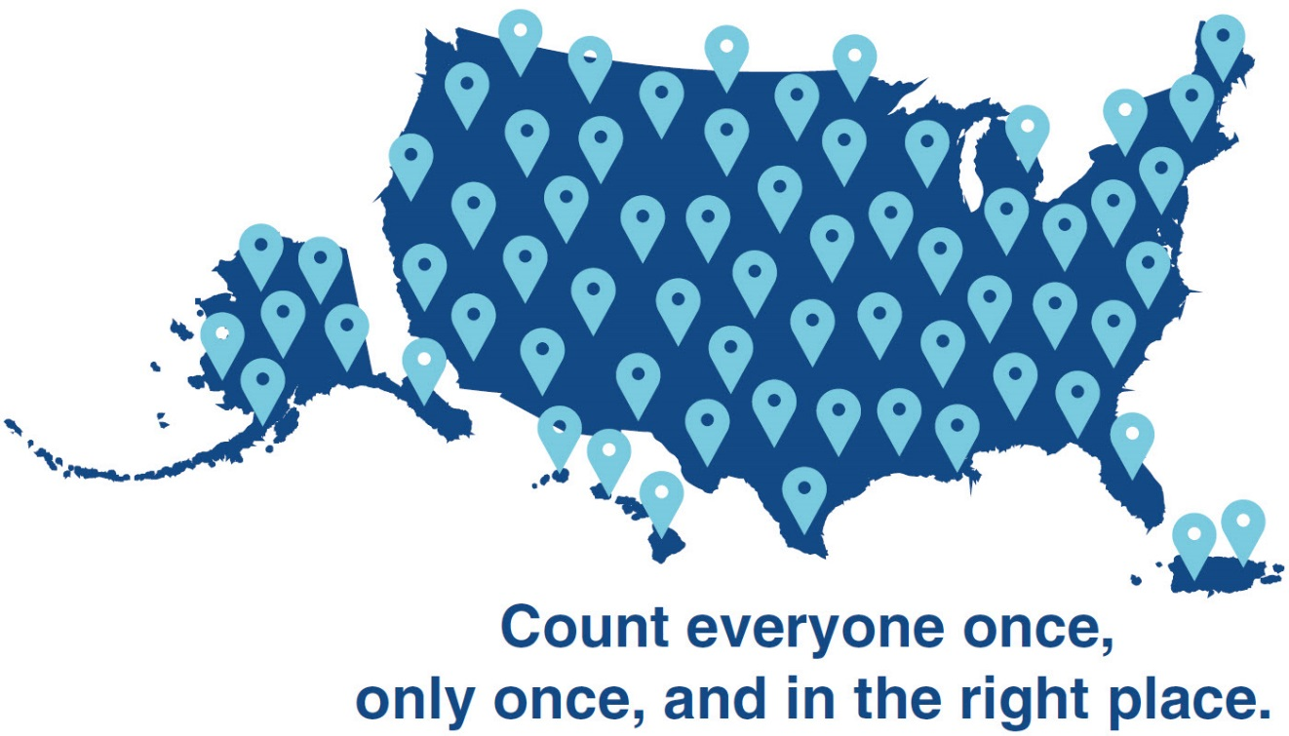
2020 Census A Complete and Accurate Count of the Population and Housing
SELF-RESPONSE
MOTIVATE PEOPLE TO RESPOND
NONRESPONSE FOLLOWUP
ESTABLISH WHERE TO COUNT
Count everyone once,
only once, and in the right place.
TABULATE DATA AND RELEASE CENSUS RESULTS
Notes:
Regardless of modern day societal challenges, our goal does not change:
To count everyone once, only once, and in the right place. At its simplest, this is what the decennial census is all about. The decennial census is the largest peacetime mobilization this country undertakes. It is an incredible amount of work and our census experts divide the entire process into 35 separate operations each with its own process and team. I like to think of it in five high-level steps.
**************ANIMATED SLIDE: PLEASE CLICK BEFORE EACH BOLD HEADING*************
ESTABLISH WHERE TO COUNT
First, we identify all addresses where people could live by conducting a 100-percent review and update of the Nation’s addresses. Legislative, school and voting districts can only be established if we know WHERE each piece of the overall population count resides. Having a complete address list that covers the entire country allows us to contact every household so that they can respond to the census. It’s also how we know who hasn’t responded so that we can reach them by other means, like knocking on their door.
MOTIVATE PEOPLE TO RESPOND
We will conduct a nationwide communications and partnership campaign by working with the trusted voices in local communities to increase participation and ultimately increase self-response. We will maximize outreach using TV, radio, newspapers, billboards, email and social media. We will make sure our advertising reaches everyone by tailoring messages to different audiences and using the right platform – TV, radio, social media – to reach each audience.
COUNT THE POPULATION PRIMARILY THROUGH SELF-RESPONSE
The 2020 Census will offer multiple ways to respond. Previous censuses asked the public to respond by mail. We’re making it quick, safe and easy for people to respond from anywhere, at any time, by using the internet, phone, or by mailing in a questionnaire. To make it easy to respond through any of those options, we will accept responses without the unique Census ID that comes on your letter or postcard that we mail to you. As always, we’ll collect data from all households, including group and unique living arrangements.
CONDUCT IN-PERSON FOLLOW-UP FOR THOSE WHO DO NOT INITIALLY RESPOND
We recognize that in spite of making it easy for people to respond there will always be a portion of the population that does not respond. But, our goal is to count everyone. So, if a household doesn’t respond on its own, we send census takers to knock on their doors and collect their information. We call this nonresponse followup.
We will use data the government already has as well as third‑party data to avoid collecting information about things we already know—like which housing units are vacant. This will reduce the number of in-person visits to vacant housing units. (In 2010, almost 30 percent of the 48 million nonresponse followup case visits were to vacant or non-existing units.)
When we do have to go knock on doors, we’re efficiently managing and routing census takers by determining the best travel routes through automation. Our census takers will use secure smartphones when they visit a household to capture people’s responses – this makes the data collection and processing much faster than if we kept using paper and pencils as we did in prior censuses.
TABULATE DATA AND RELEASE CENSUS RESULTS
We do all of this in order to provide complete and accurate census data. Consistent with prior censuses, we will deliver apportionment counts to the President (by December 31, 2020) and redistricting counts to the states (by March 31, 2021).
We are also building on recent efforts to give the public greater access to the data by releasing census results on a new, user‑friendly web platform featuring easier search functionality, visualizations, and navigation to enhance dissemination and increase access to data tables and data sets through data.census.gov.

Slide 4
Workshop Objectives
Build connections and seed collaborations between organizations and individuals committed to a successful 2020 Census
Develop actionable concepts that can lead to a stronger awareness & outreach campaigns to reach the communities you serve
Build momentum towards making ideas come to life by generating commitments and developing them through 2020
Showcase a model that other cities and towns can use to generate collaborative relationships with stakeholders and ideas to reach their own hard to count populations

Slide 5
Think about your role as you plan for 2020 ...
Collaborate, Coordinate, and Convene
Advocate for Resources
Educate, Motivate and Mobilize

Slide 6
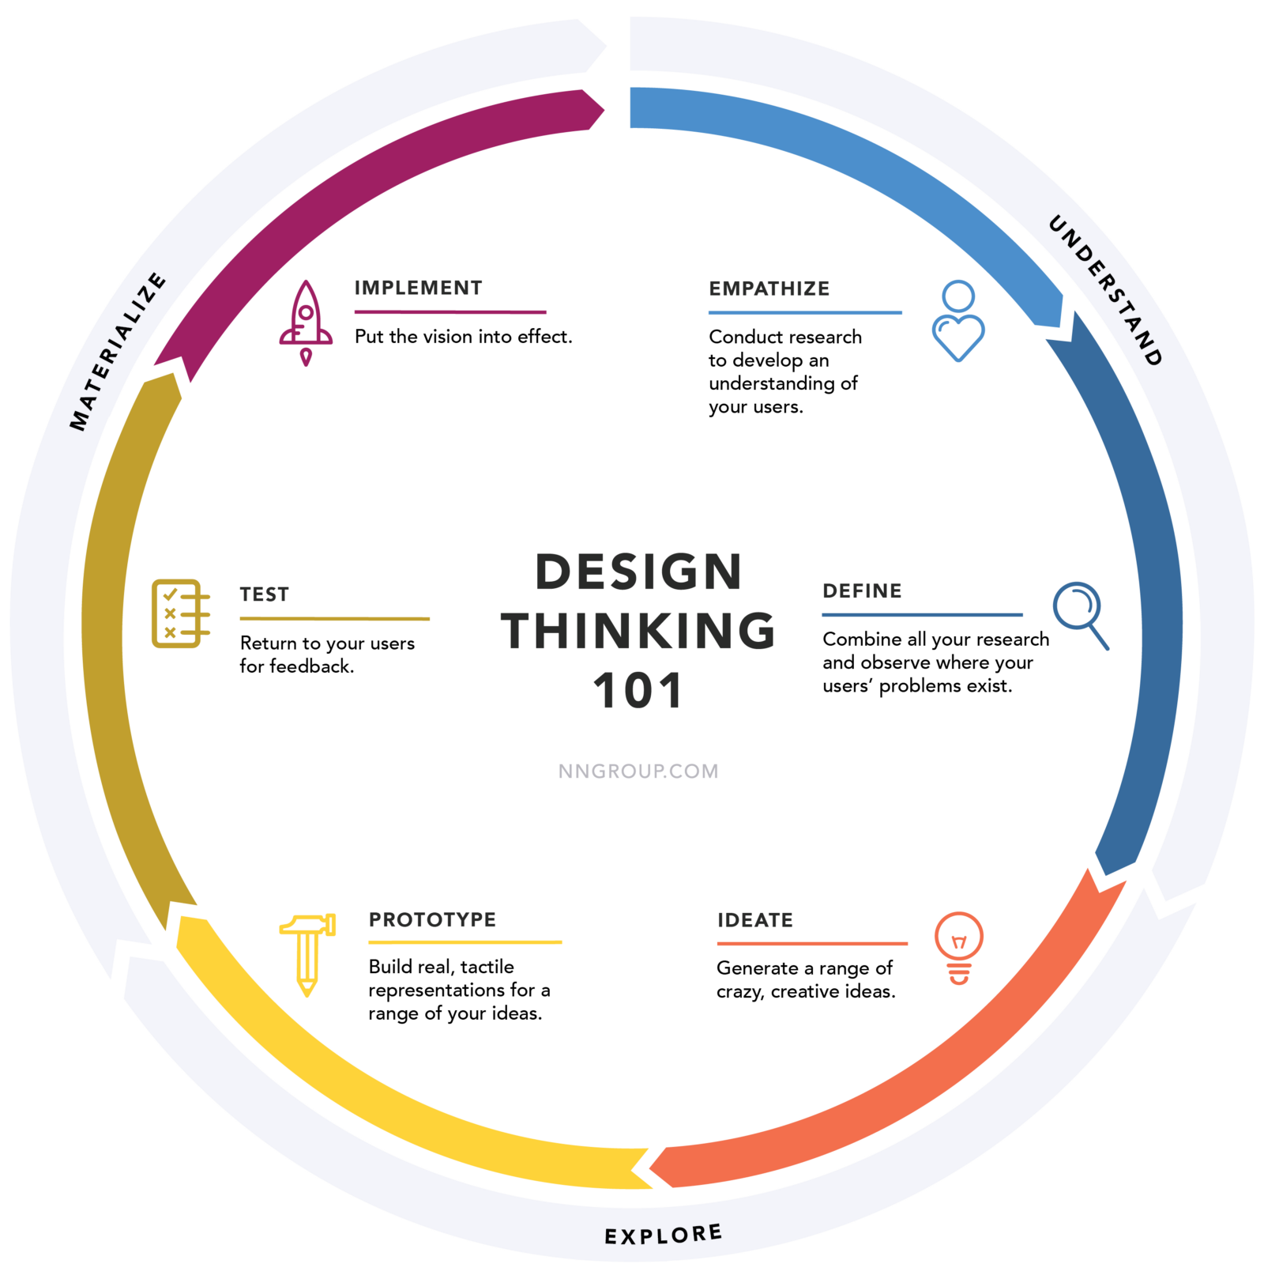
Design Thinking 101
Source: Nielsen Norman Group

Slide 7
Sprint Principles
GUIDING PRINCIPLES
Avoiding groupthink
Parallel is better than serial
The magic of time constraint
THINGS TO KEEP IN MIND
Leverage existing resources + “blue sky”- it
Diverge then converge
Have fun & trust the process!

Slide 8
What are the top 3 challenges you are facing in advance of the 2020 Census?
What is your vision of success?
As we go through the upcoming activities, think about...

Slide 9
Your Challenge Statement
How might we engage our local communities for successful promotion, involvement, and execution of the 2020 Census?

Slide 10
What is a persona...
A persona represents characteristics, demographics, attitudes, behaviors, challenges and motivators
of a group(s) or community
Pg. Activities- 9/ Resources Sec (last 5-6 pages)

Slide 11
“I have trouble completing census forms.”
“I don’t have time to fill out the census forms.”
Your audience may not be native English speakers and find Census forms confusing.
Your audience is very busy and assumes the Census will be time-consuming and cumbersome.
“I don’t trust the government with my information.”
“I don’t think the census has any impact on my life.”
Your audience is concerned about data privacy or having their information used by other federal agencies.
Your audience isn’t sure what Census does, how its data affects them, and why their participation matters.

Slide 12
Solo Ideation
Write as many concrete ideas or concepts as possible
that addresses the challenge statement selected.
One (1) statement per sticky note
Notes:
Pg. Activities- 10 of toolkit

Slide 13
Post Up!
One person at a time, read your own sticky notes out to the group as you post them on the wall.
Take your markers with you!
Pg. Activities- 10
Notes:
Pick up all your stickys and go to the assigned wall area. Read your stickys outloud to the group as you post them up, one person at a time

Slide 14
Clustering could look like...
Group ideas (cluster) together based on common topics, themes or affinity.

Slide 15
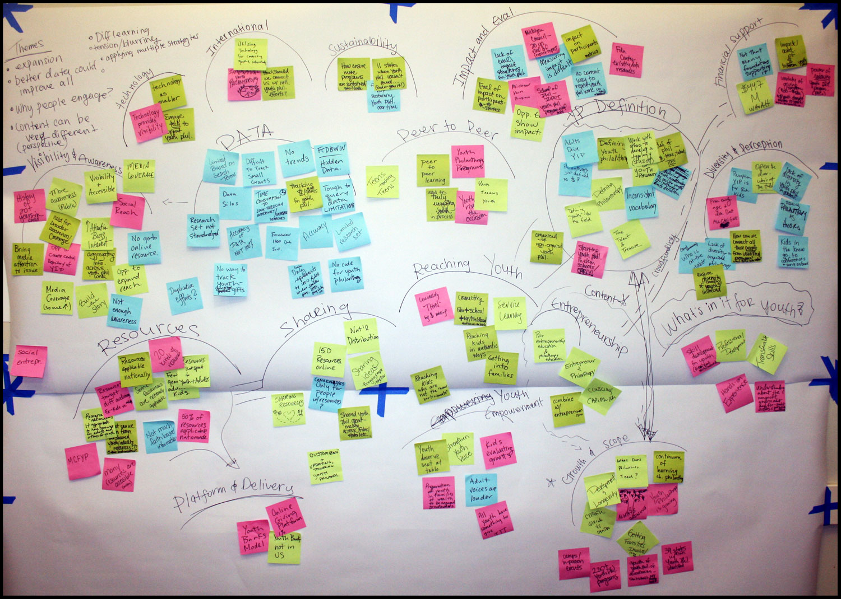

Slide 16
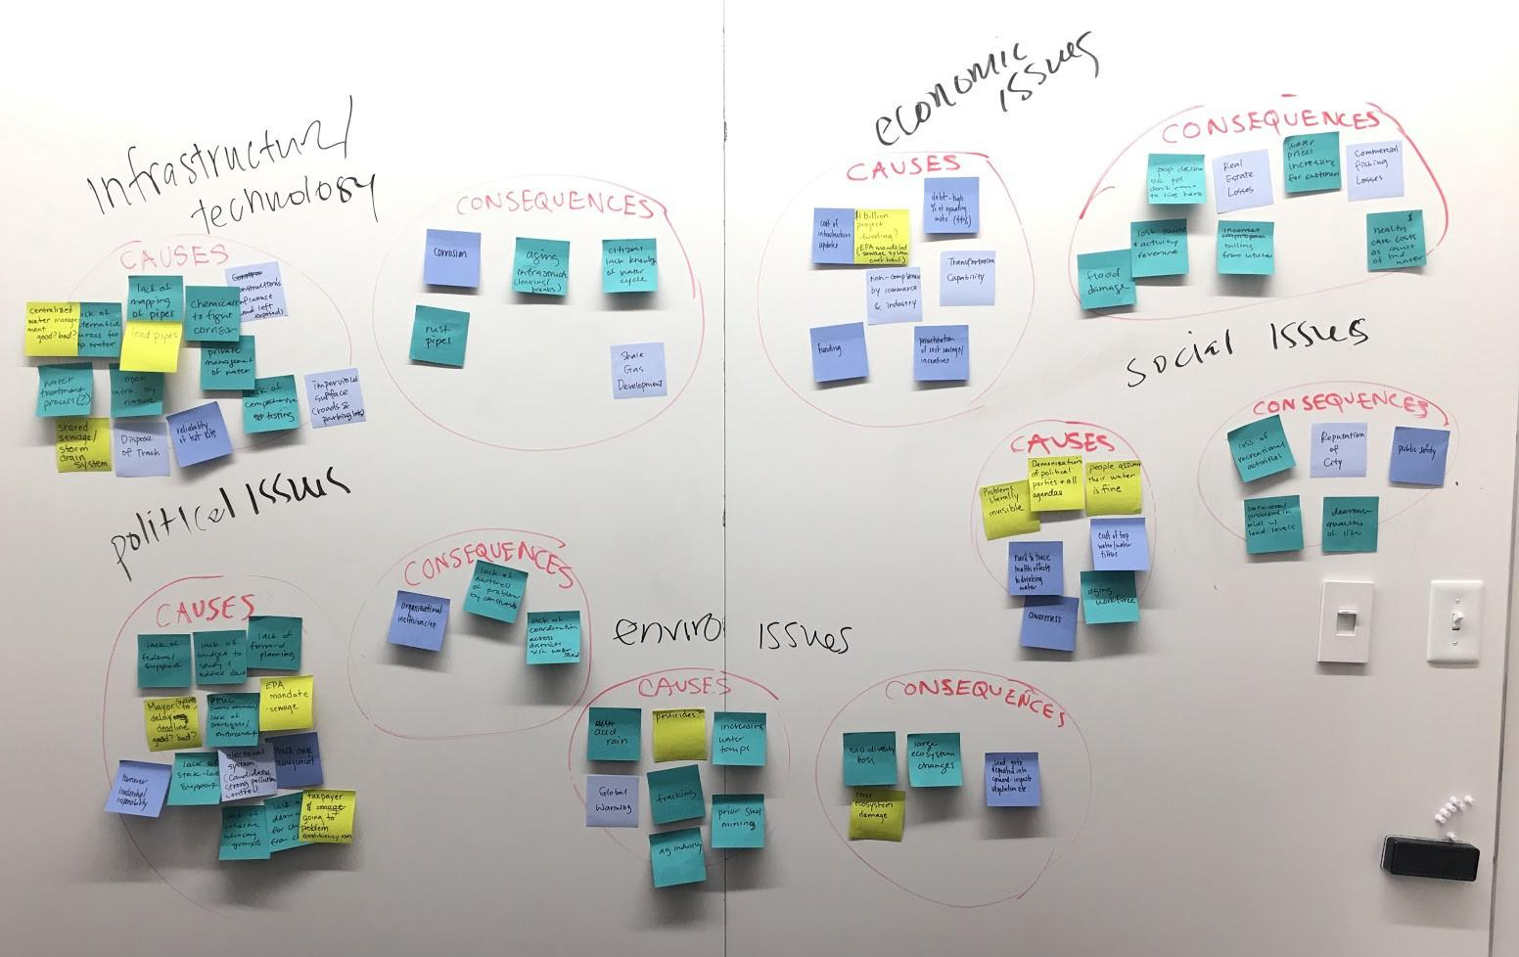

Slide 17
Now, lets Cluster!
Group ideas (cluster) together based on common topics, themes or affinity.

Slide 18
Dot Voting + Selection
3 votes (dots) per person,
then select the idea with the most votes or group of ideas (no more than 2-3 stickys).
You will work with this concept moving forward.
Notes:
You can put all your 3 vote on one sticky or separate stickys, as long as you use your 3 votes! Draw a circle (dot) on the top 3 ideas. (individual exercise, no groupthink!) Select which solution to work with

Slide 19
Fleshing Out Your Idea...

Slide 21
Who is our idea designed for? One of the scenarios, or someone else? (i.e. policymaker, grasstops, etc.)
What is a tool, campaign, program, initiative or other concept that we can create?
Guiding questions:
How are people going to find out about it?
How does it make people feel?
Who can we partner with?
What are the existing resources around this table to pull this off?
What are references for this kind of idea?
What is the call to action?
What are some ways you can promote or socialize this concept or idea?

Slide 22
Develop a Storyboard!
A storyboard could look like...

Slide 23
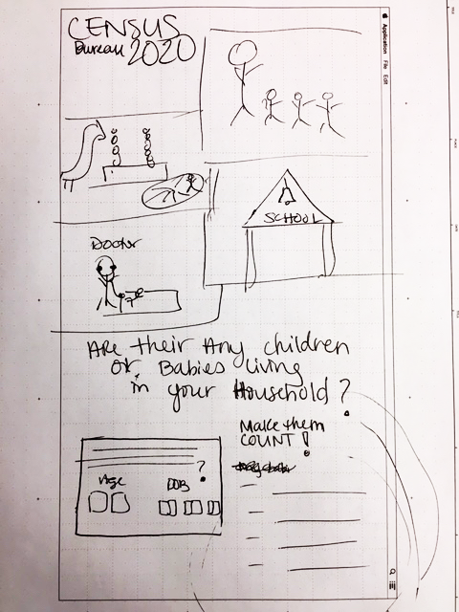
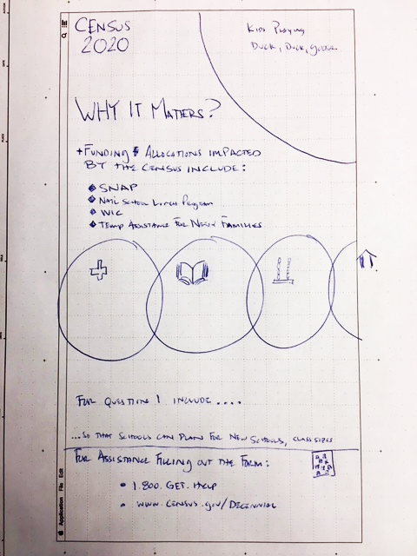

Slide 24
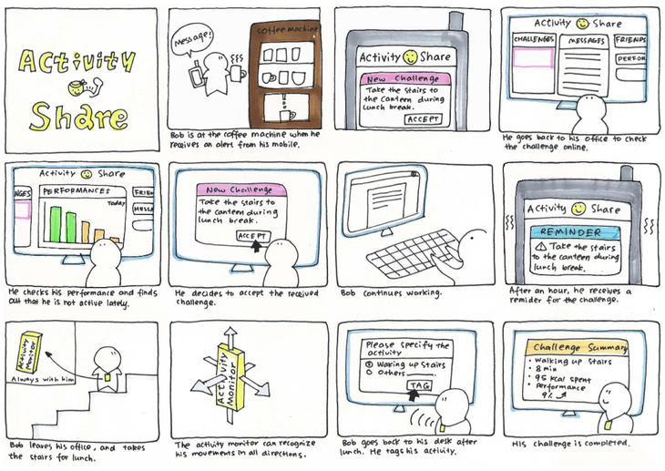

Slide 25
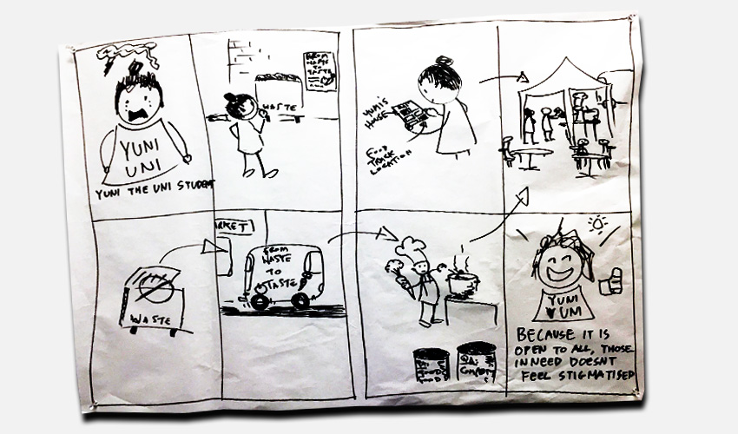

Slide 26
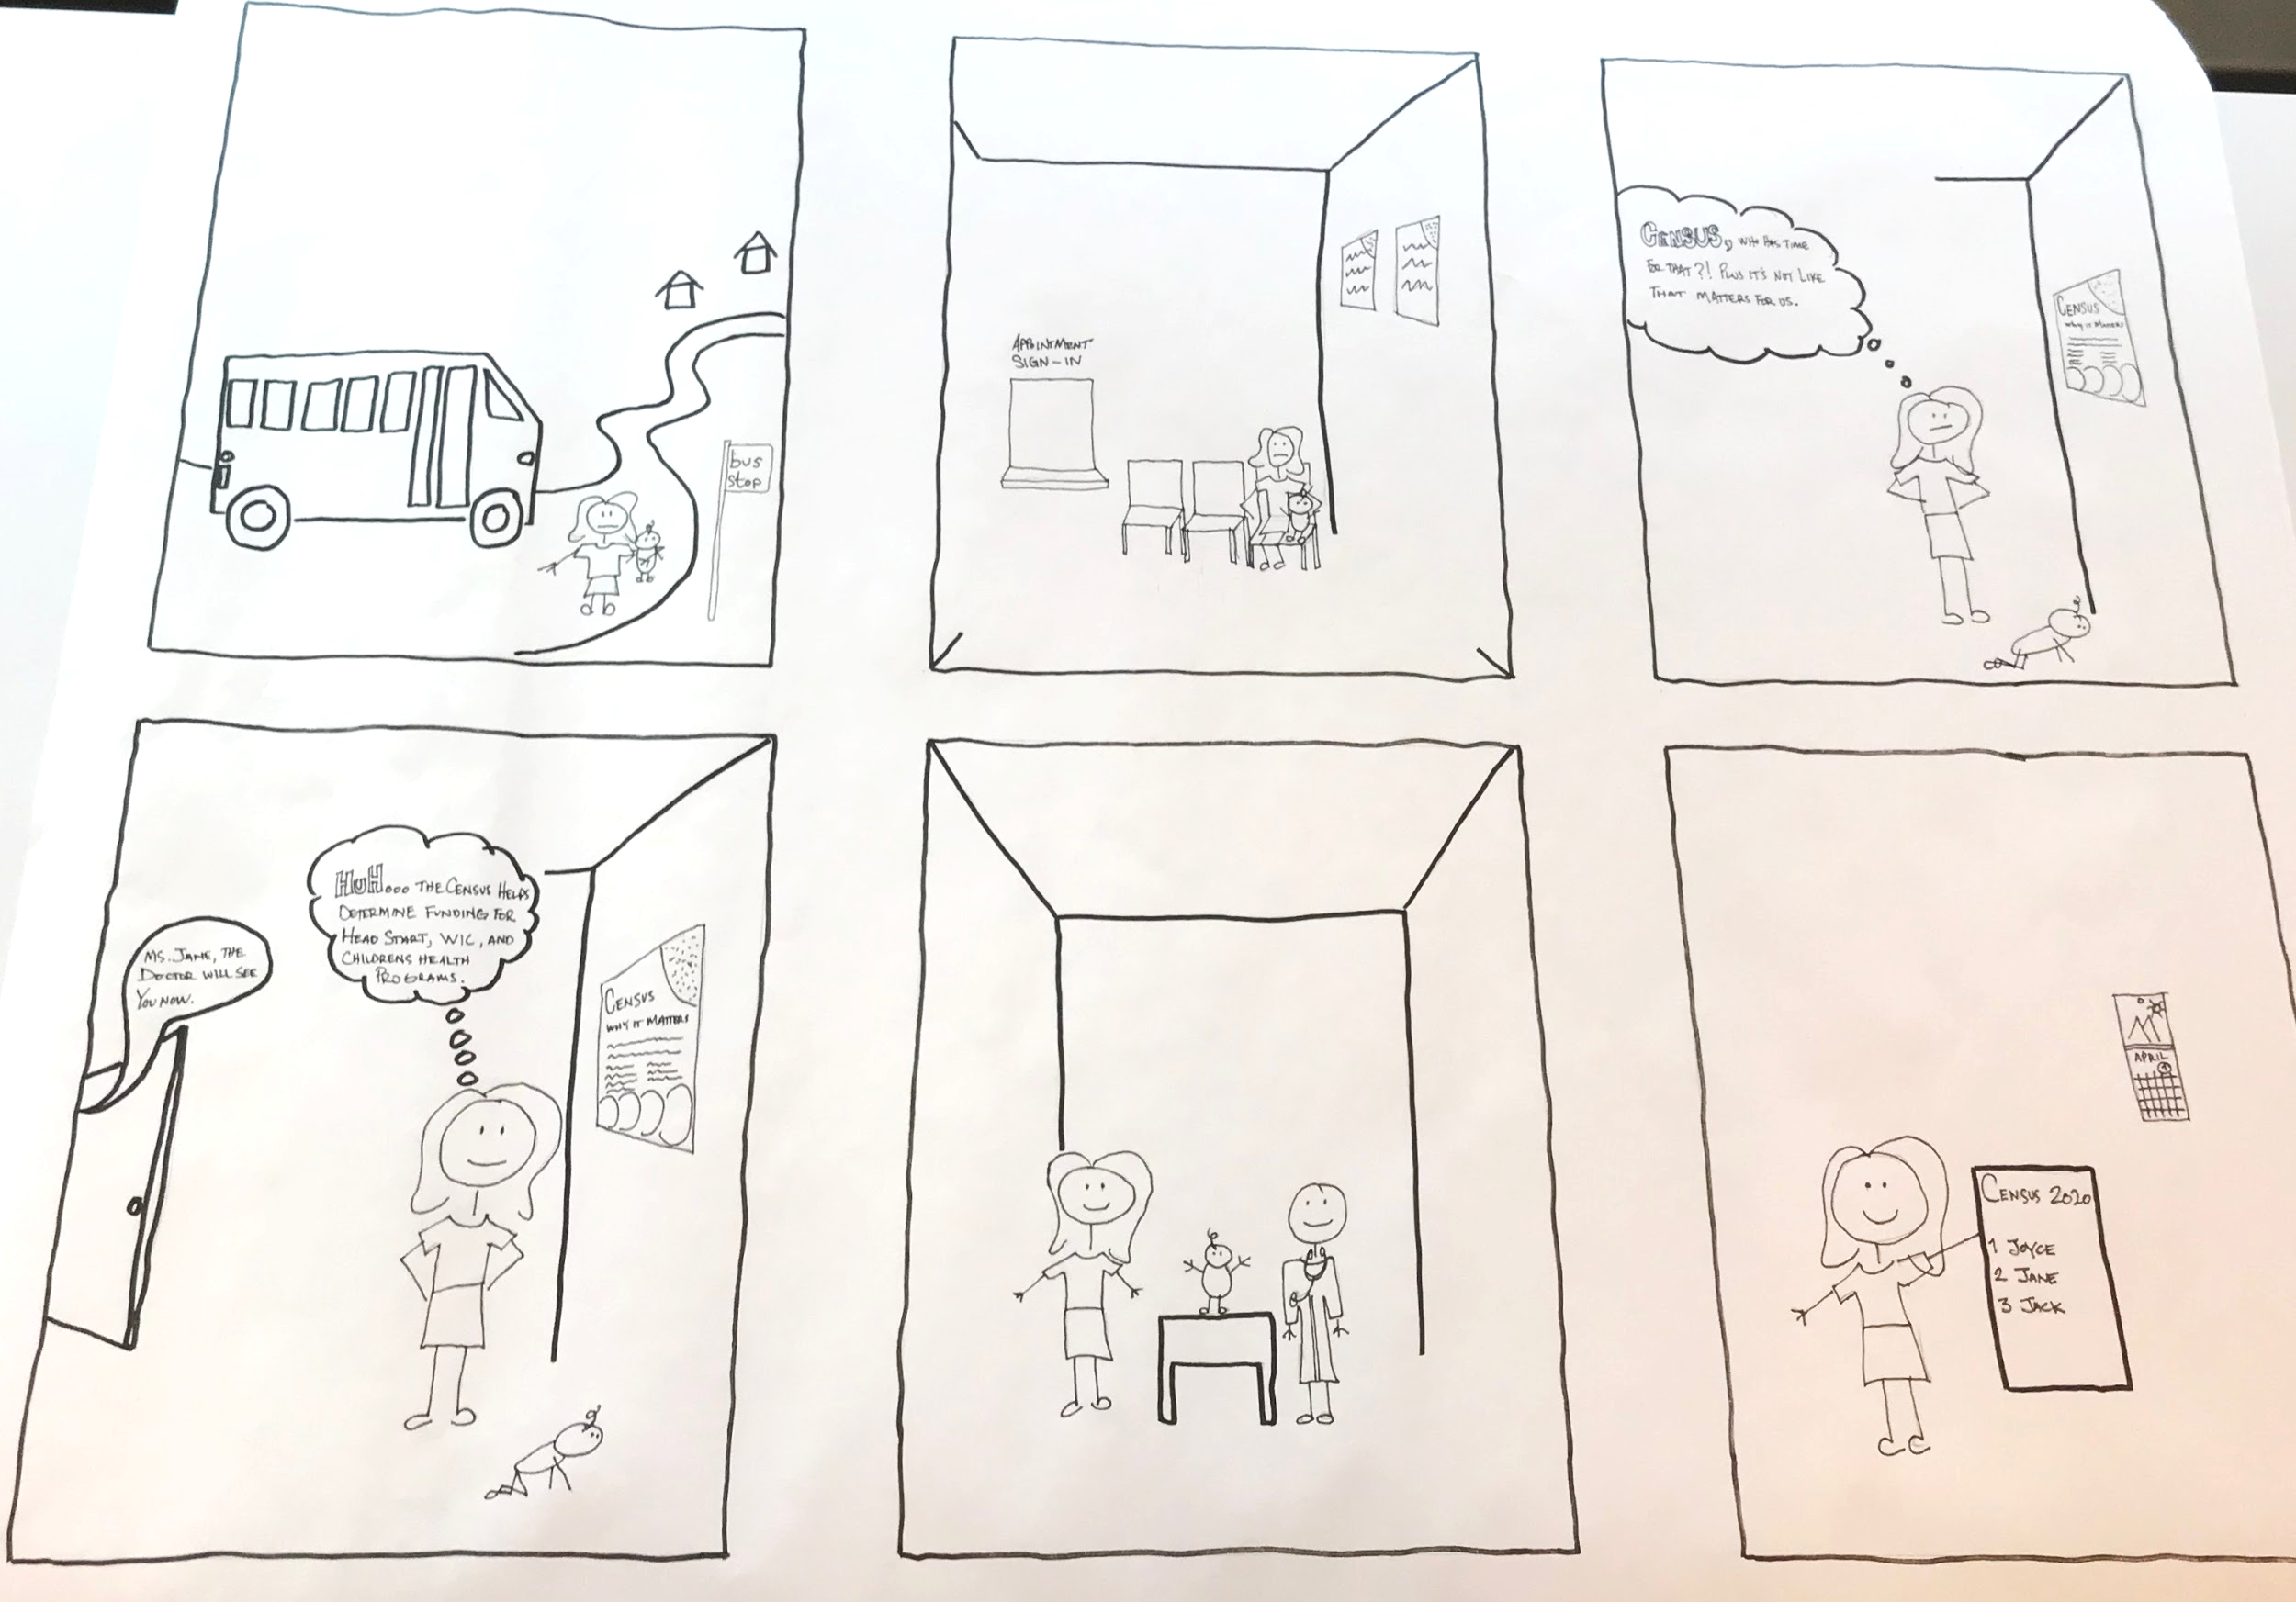

Slide 27
The Pitch:
Teams Share Outs
Select one person in the group to present your idea/concept
+
One person to hold up the flip chart
Notes:
Describe your persona/user, what you are trying to communicate to that persona and your concept or idea...

Slide 28
Contribution Sheets
Fill out commitments sheets (one per person) and leave them facedown in the middle of the table.

Slide 29
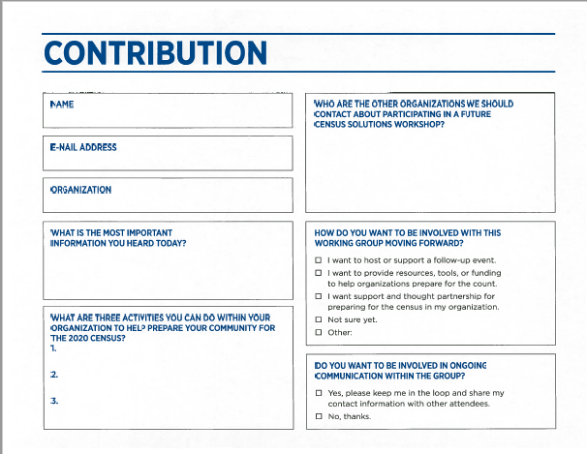

Slide 30
CENSUS SOLUTIONS WORKSHOP TOOLKIT

Slide 31
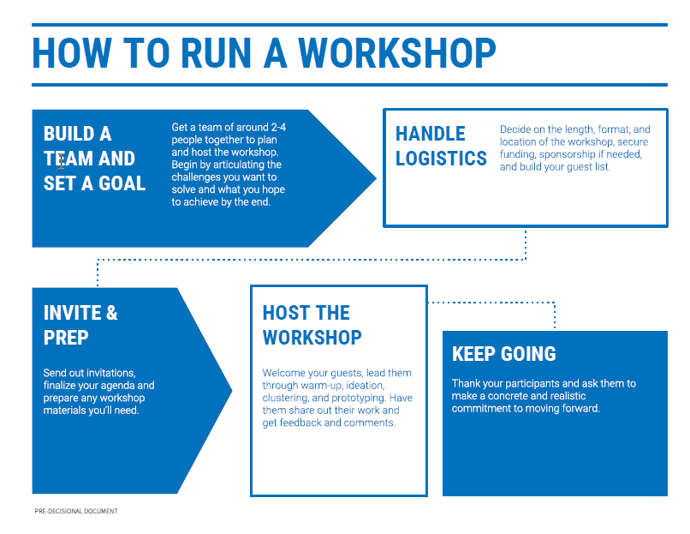
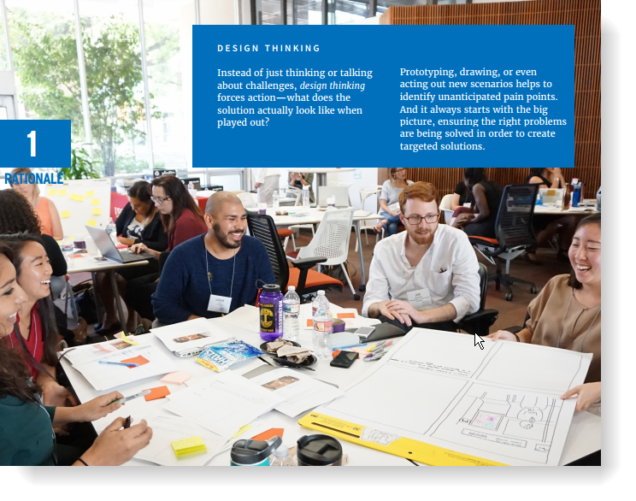
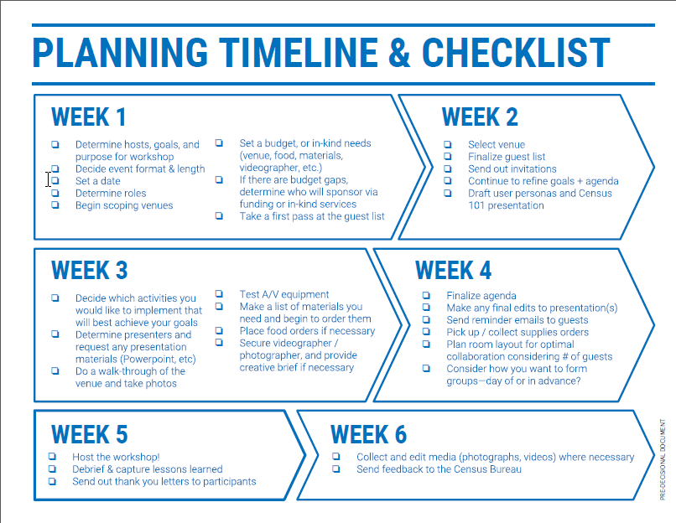
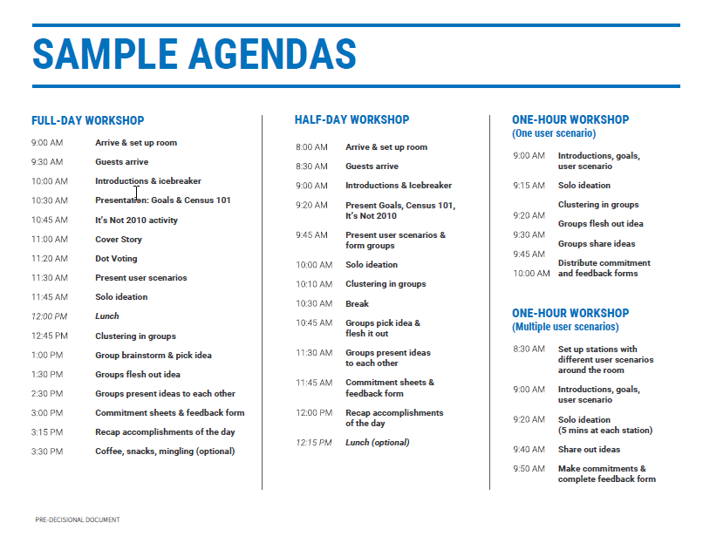
PRE-DECISIONAL DOCUMENT

Slide 32
THANK YOU

Slide 33
census.partners@census.gov
census.gov/partners
OFFICE OF CONGRESSIONAL AND
INTERGOVERNMENTAL AFFAIRS
Haley Ashcom
haley.m.ashcom@census.gov

