Slide 1

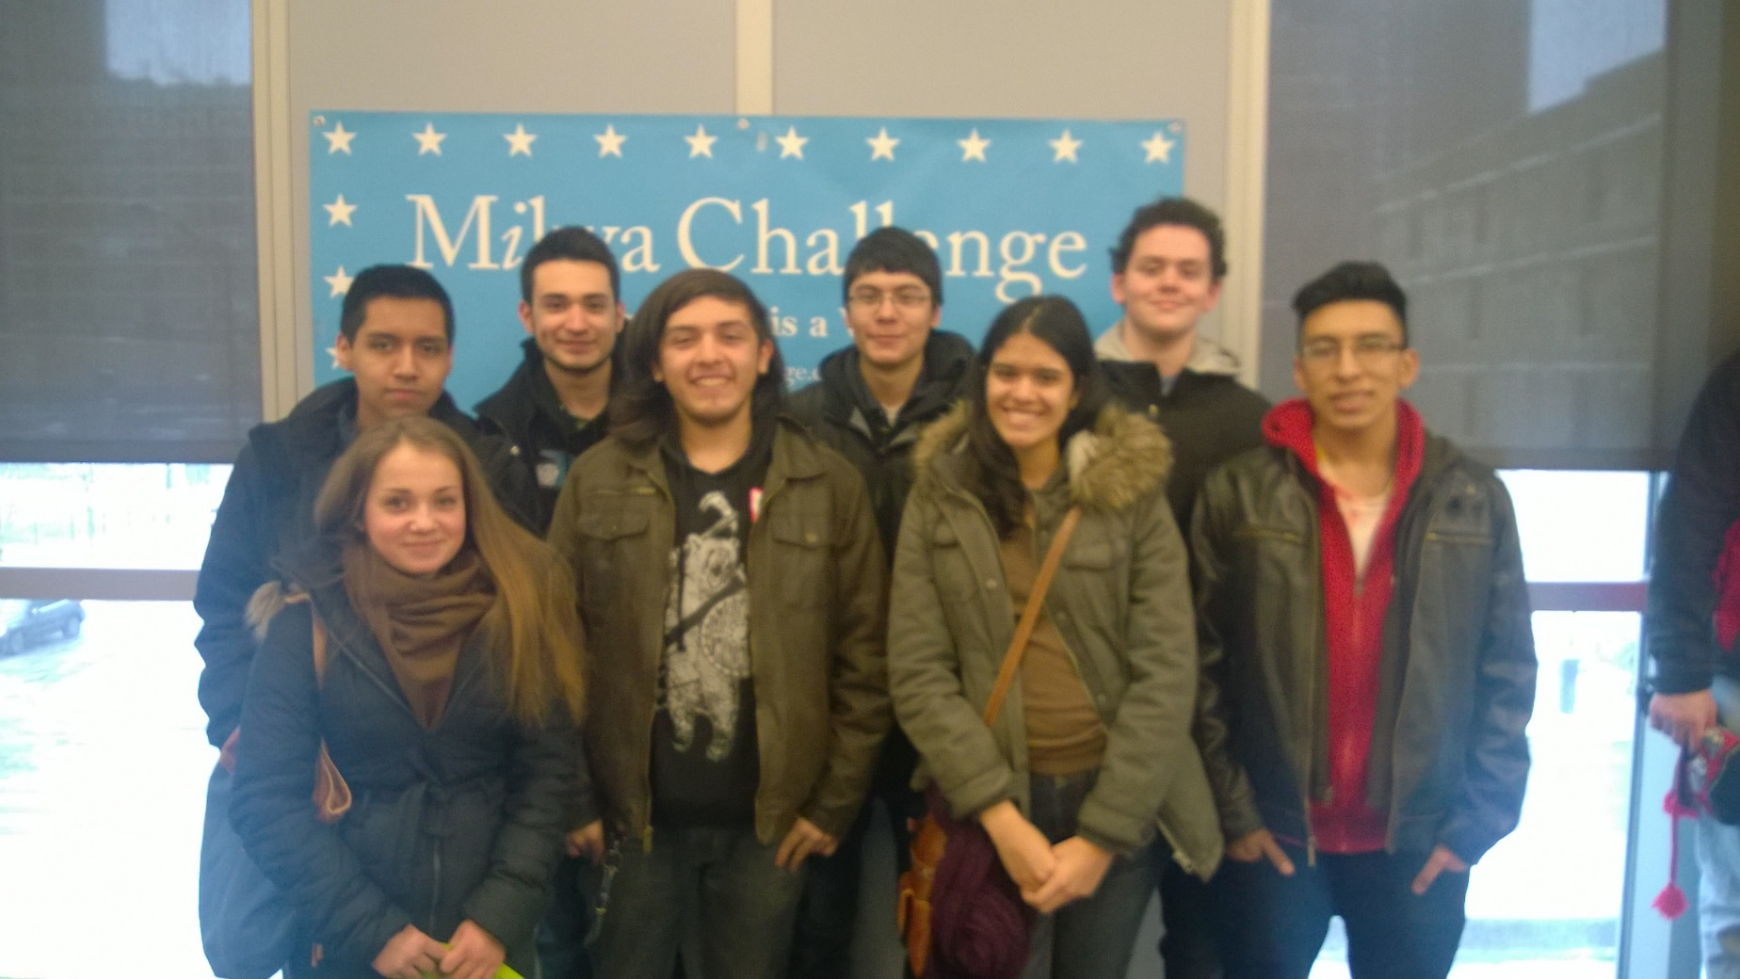
Mikva Challenge
Democracy is a Verb.
Notes:
Put new logo in here

Slide 2
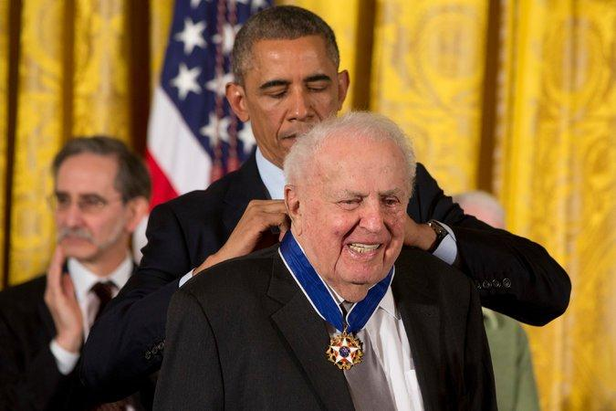
MISSION & VISION
Mikva Challenge develops youth to be empowered, informed, and active citizens who will promote a just and equitable society.
Mikva Challenge envisions a stronger, inclusive democracy that values youth voice.
Abner Mikva being awarded the
Presidential Medal of Freedom in 2014.
Notes:
Non-partisan; non-profit
Mikva Challenge -- Founded in 1998 as a tribute to former White House Counsel, Judge and U.S. Congressman Abner Mikva
and his wife Zoe, a teacher and lifelong education activist.
Mission/vision??

Slide 3
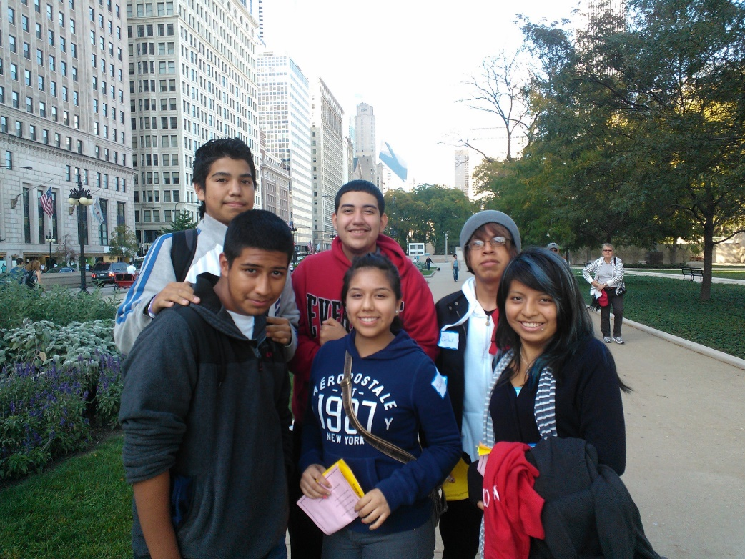
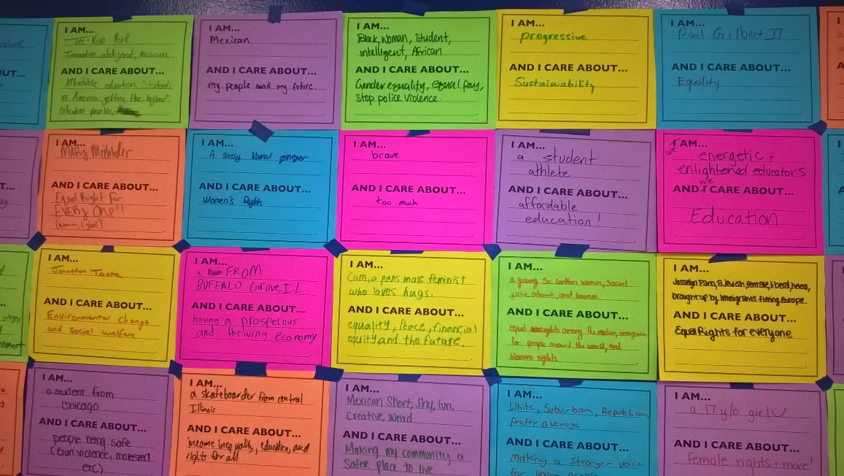
WHAT IS MIKVA?
Increased Classroom Community & Engagement
Authentic Support & Professional Development
Developing Youth Leader
Championing Youth Voice
Transforming Civic Education
Abner Mikva being awarded the
Presidential Medal of Freedom in 2014.
Notes:
Non-partisan; non-profit
Mikva Challenge -- Founded in 1998 as a tribute to former White House Counsel, Judge and U.S. Congressman Abner Mikva
and his wife Zoe, a teacher and lifelong education activist.

Slide 4
QUALITY PROGRAMS OF ENGAGEMENT
Elections in Action prepares young people to participate in elections through volunteering as poll workers and judges, campaign aides, hosts of candidate forums, voter registration leaders, and creators of voter education guides.
Issues to Action and Project Soapbox involves young people in community problem solving that starts with community analysis and culminates in showcases of civic action with community leaders.
Mikva Youth Policy Councils advise city leaders on public policy issues affecting youth. Students do a deep dive into a public-policy problem, develop policy recommendations to present to city leaders and help implement them.
Mikva Government Fellows involves young people in public-sector internships where they learn how to serve constituents, work in the civic sector, and hone their civic-leadership skills.
Mikva Professional Development works with teachers and school administrators to train, coach, and support Action Civics instruction in schools.
Notes:
Short description for each-
Highlight issues to action & project soapbox

Slide 5
Mikva
Challenge
Youth
Voice
Action
Civics
Learn
by
Doing
Youth
Expertise
Reflection
Notes:
Develop the next generation of civic leaders
Issues that matter to youth

Slide 6
Ladder of Youth Participation
Non Participation Degrees of Participation
Youth-initiated, shared decisions with adults
Youth-initiated and directed
Adult-initiated, shared decisions with youth
Consulted and informed
Assigned but informed
Tokenism
Decoration
Manipulation

Slide 7
Mikva
Challenge
6 Step Activism Process
1. Examine
Community
6. Take Action
2. Identify
Issues
Reflection
5. Develop Strategies
3. Conduct Research
4. Analyze
Power

Slide 8
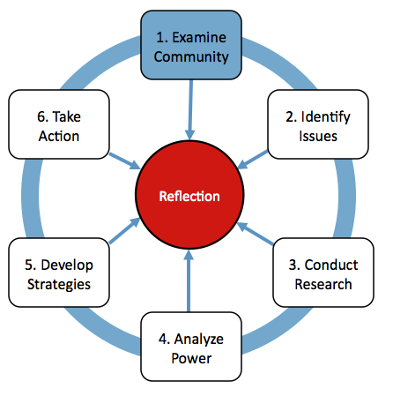
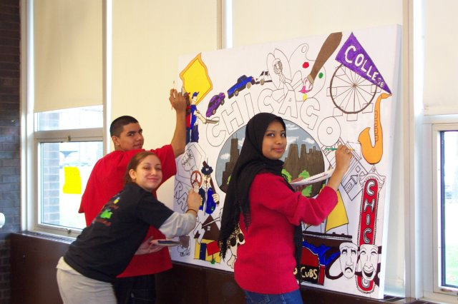
1. Examine Community

Slide 9
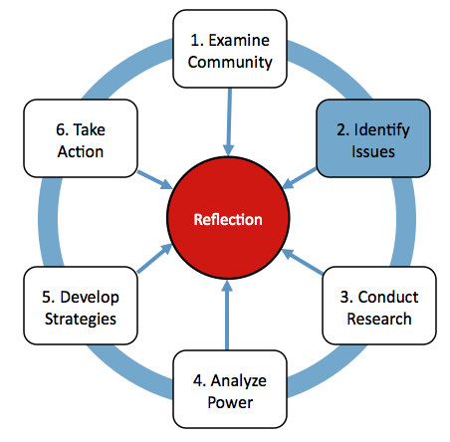
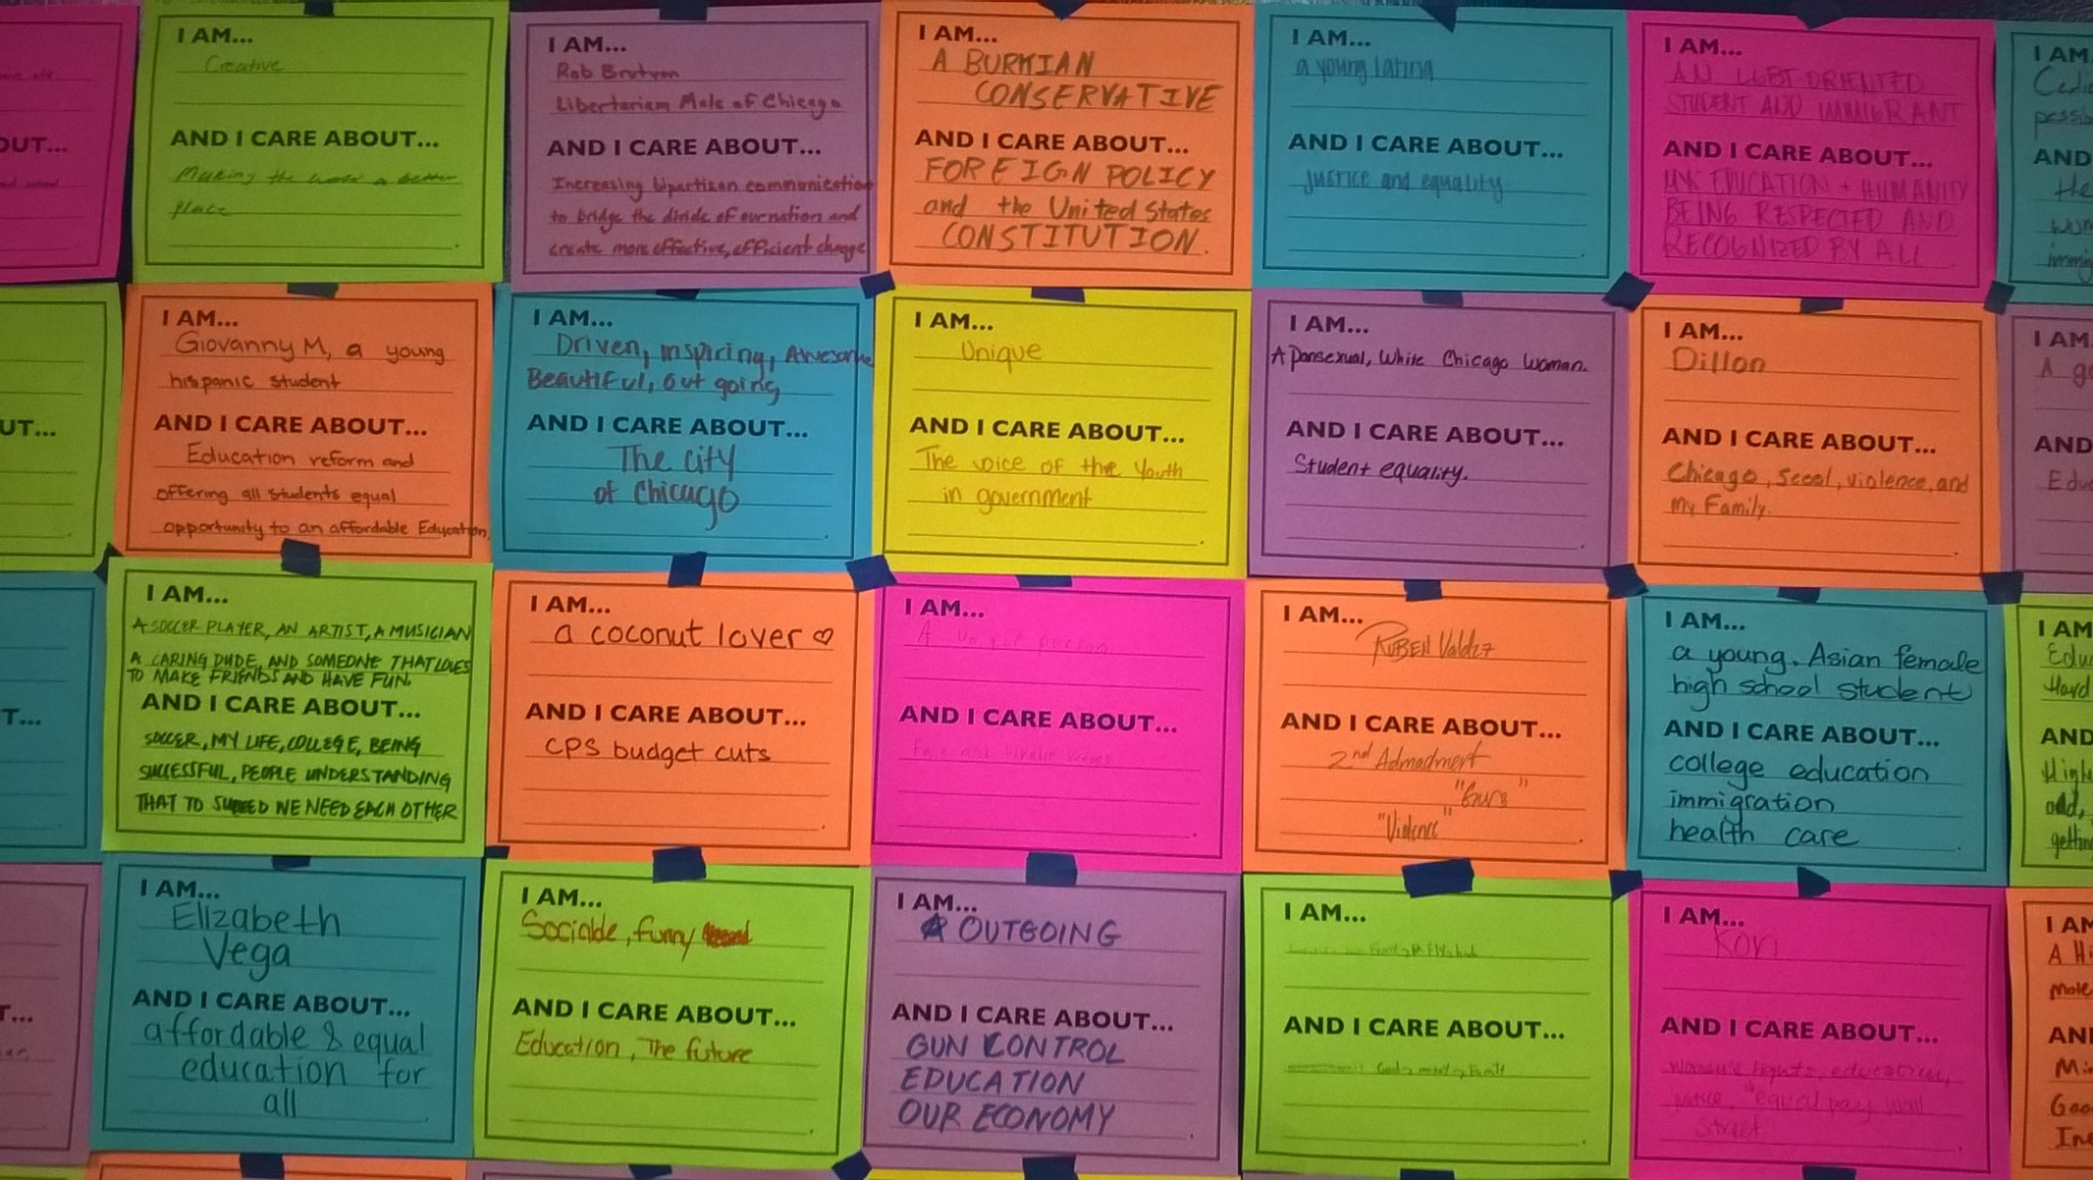
2. Identify Issues

Slide 10
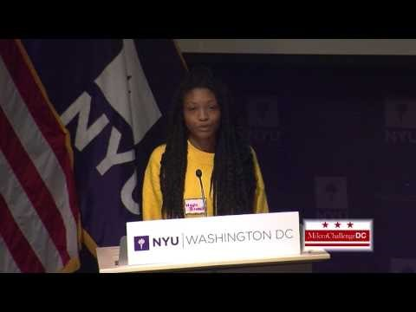
Project Soapbox
Soapbox speeches are two-minutes long.
A soapbox speech is about an issue that the student identifies, not an assigned topic.
It includes relevant research and evidence on the issue.
It addresses a specific audience.
It includes a call to action.
Notes:
Maya Branch Soapbox https://www.youtube.com/watch?v=Dc4YHklKgho

Slide 11
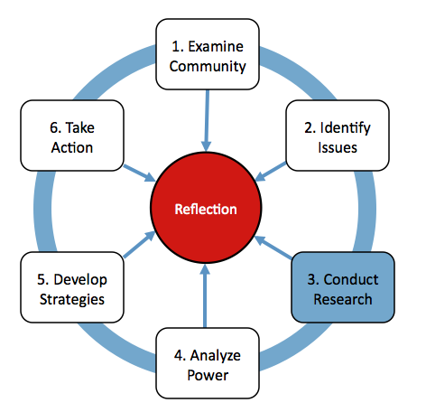
3. Research
SYMPTOMS
ROOT CAUSES

Slide 12
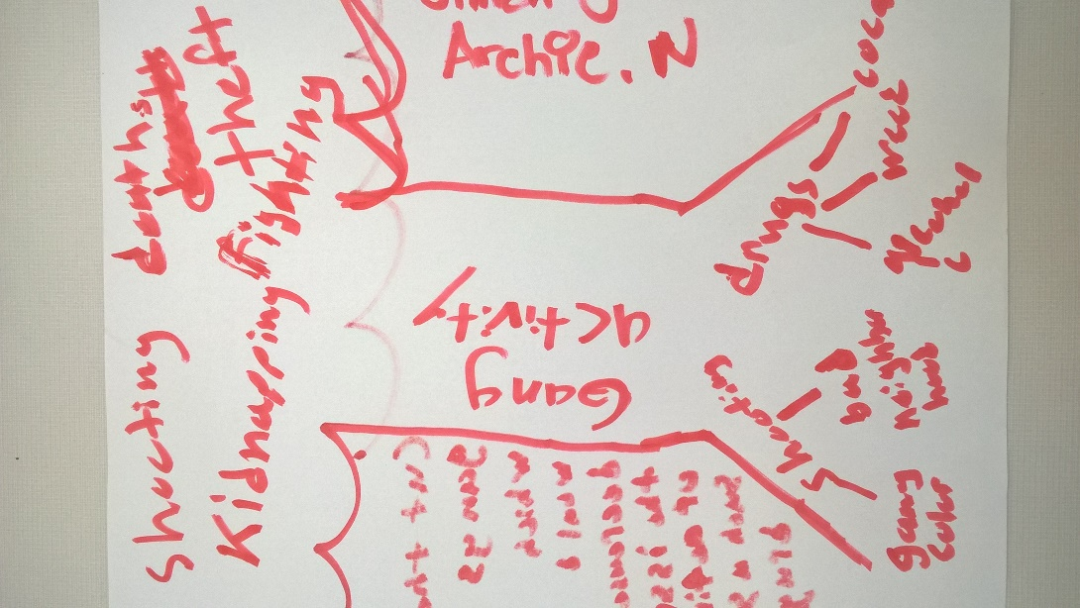
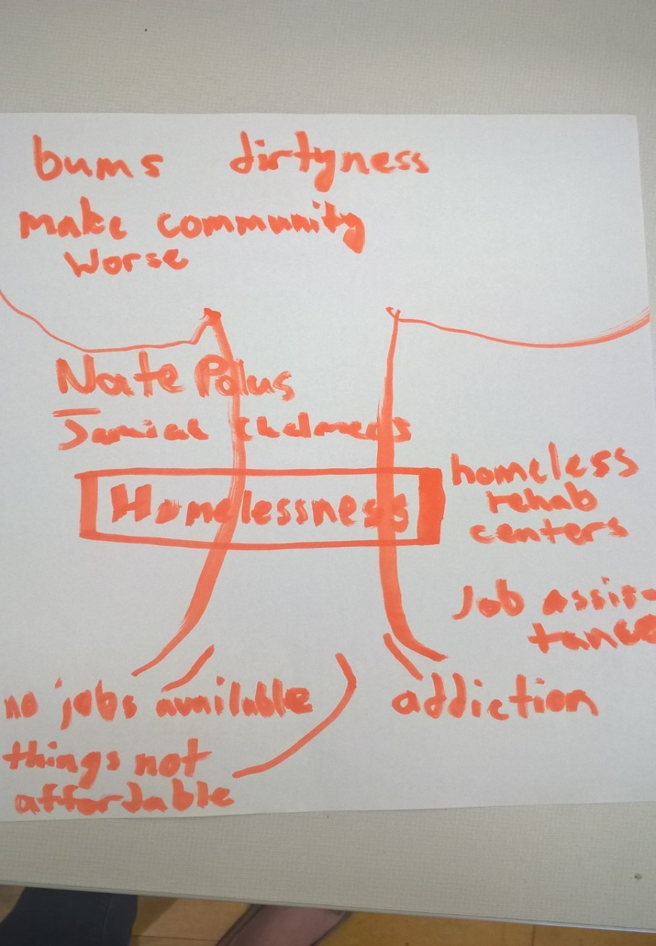
Root Cause Tree

Slide 13
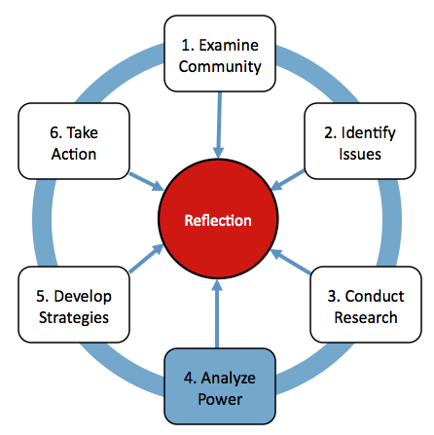
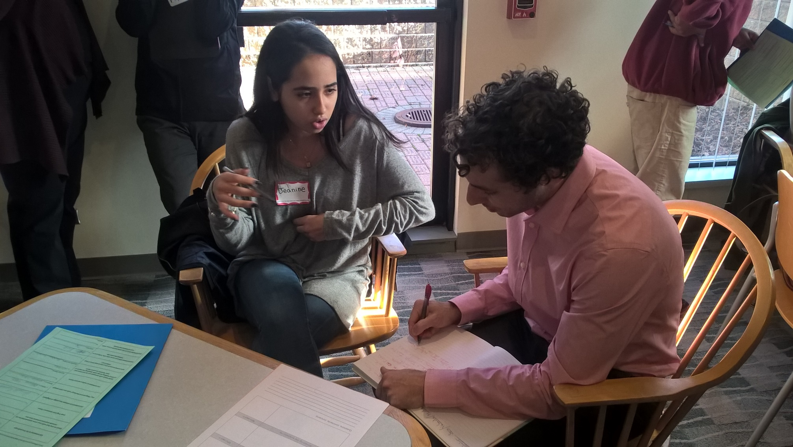
4. Analyze Power

Slide 14
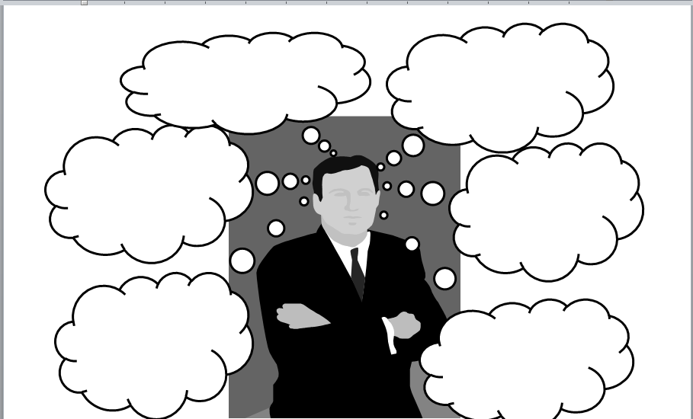
Self-Interest Analysis

Slide 15
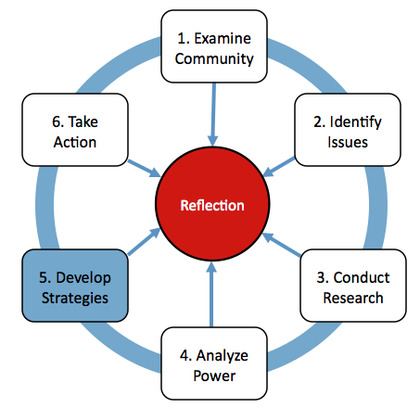
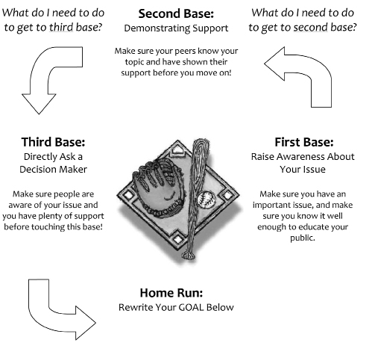
5. Develop Strategies

Slide 16
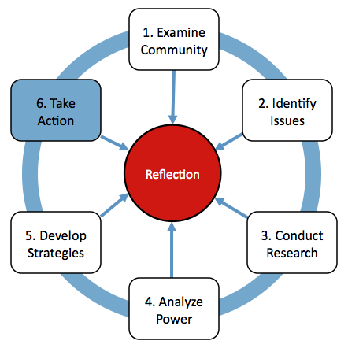
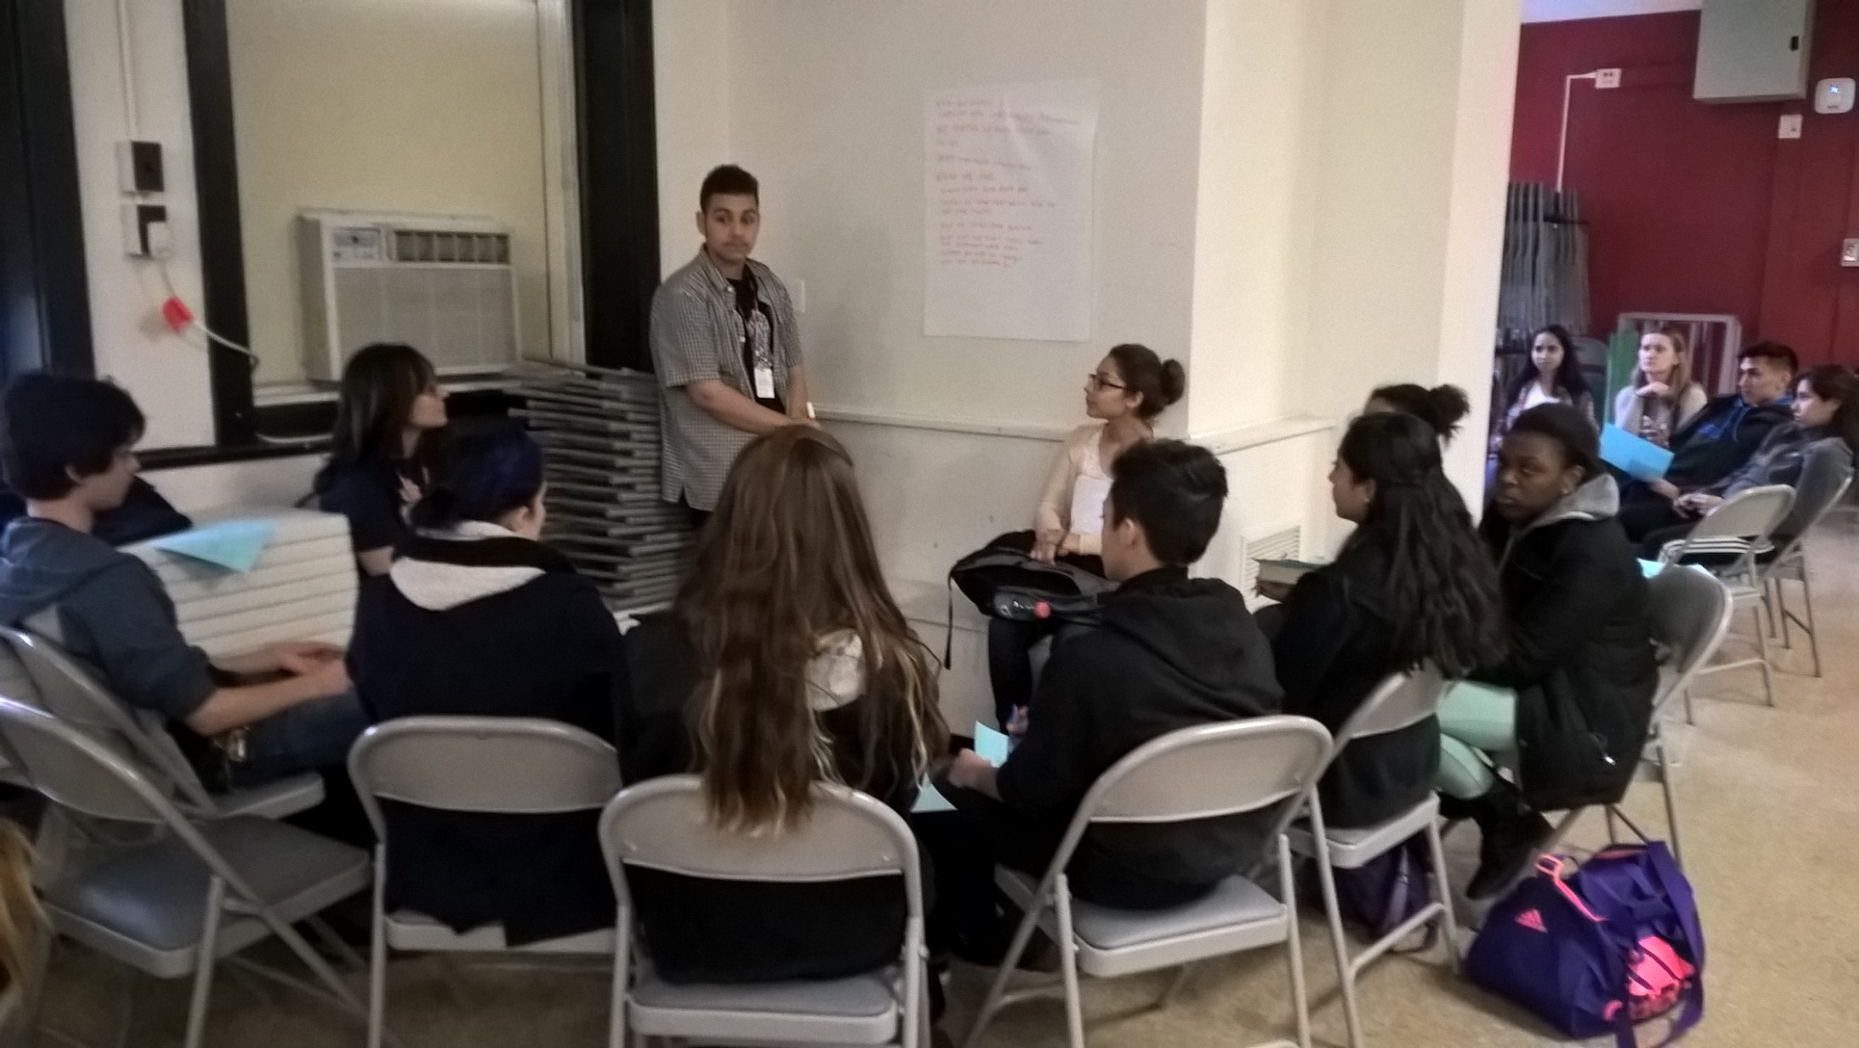
6. Take Action

Slide 17
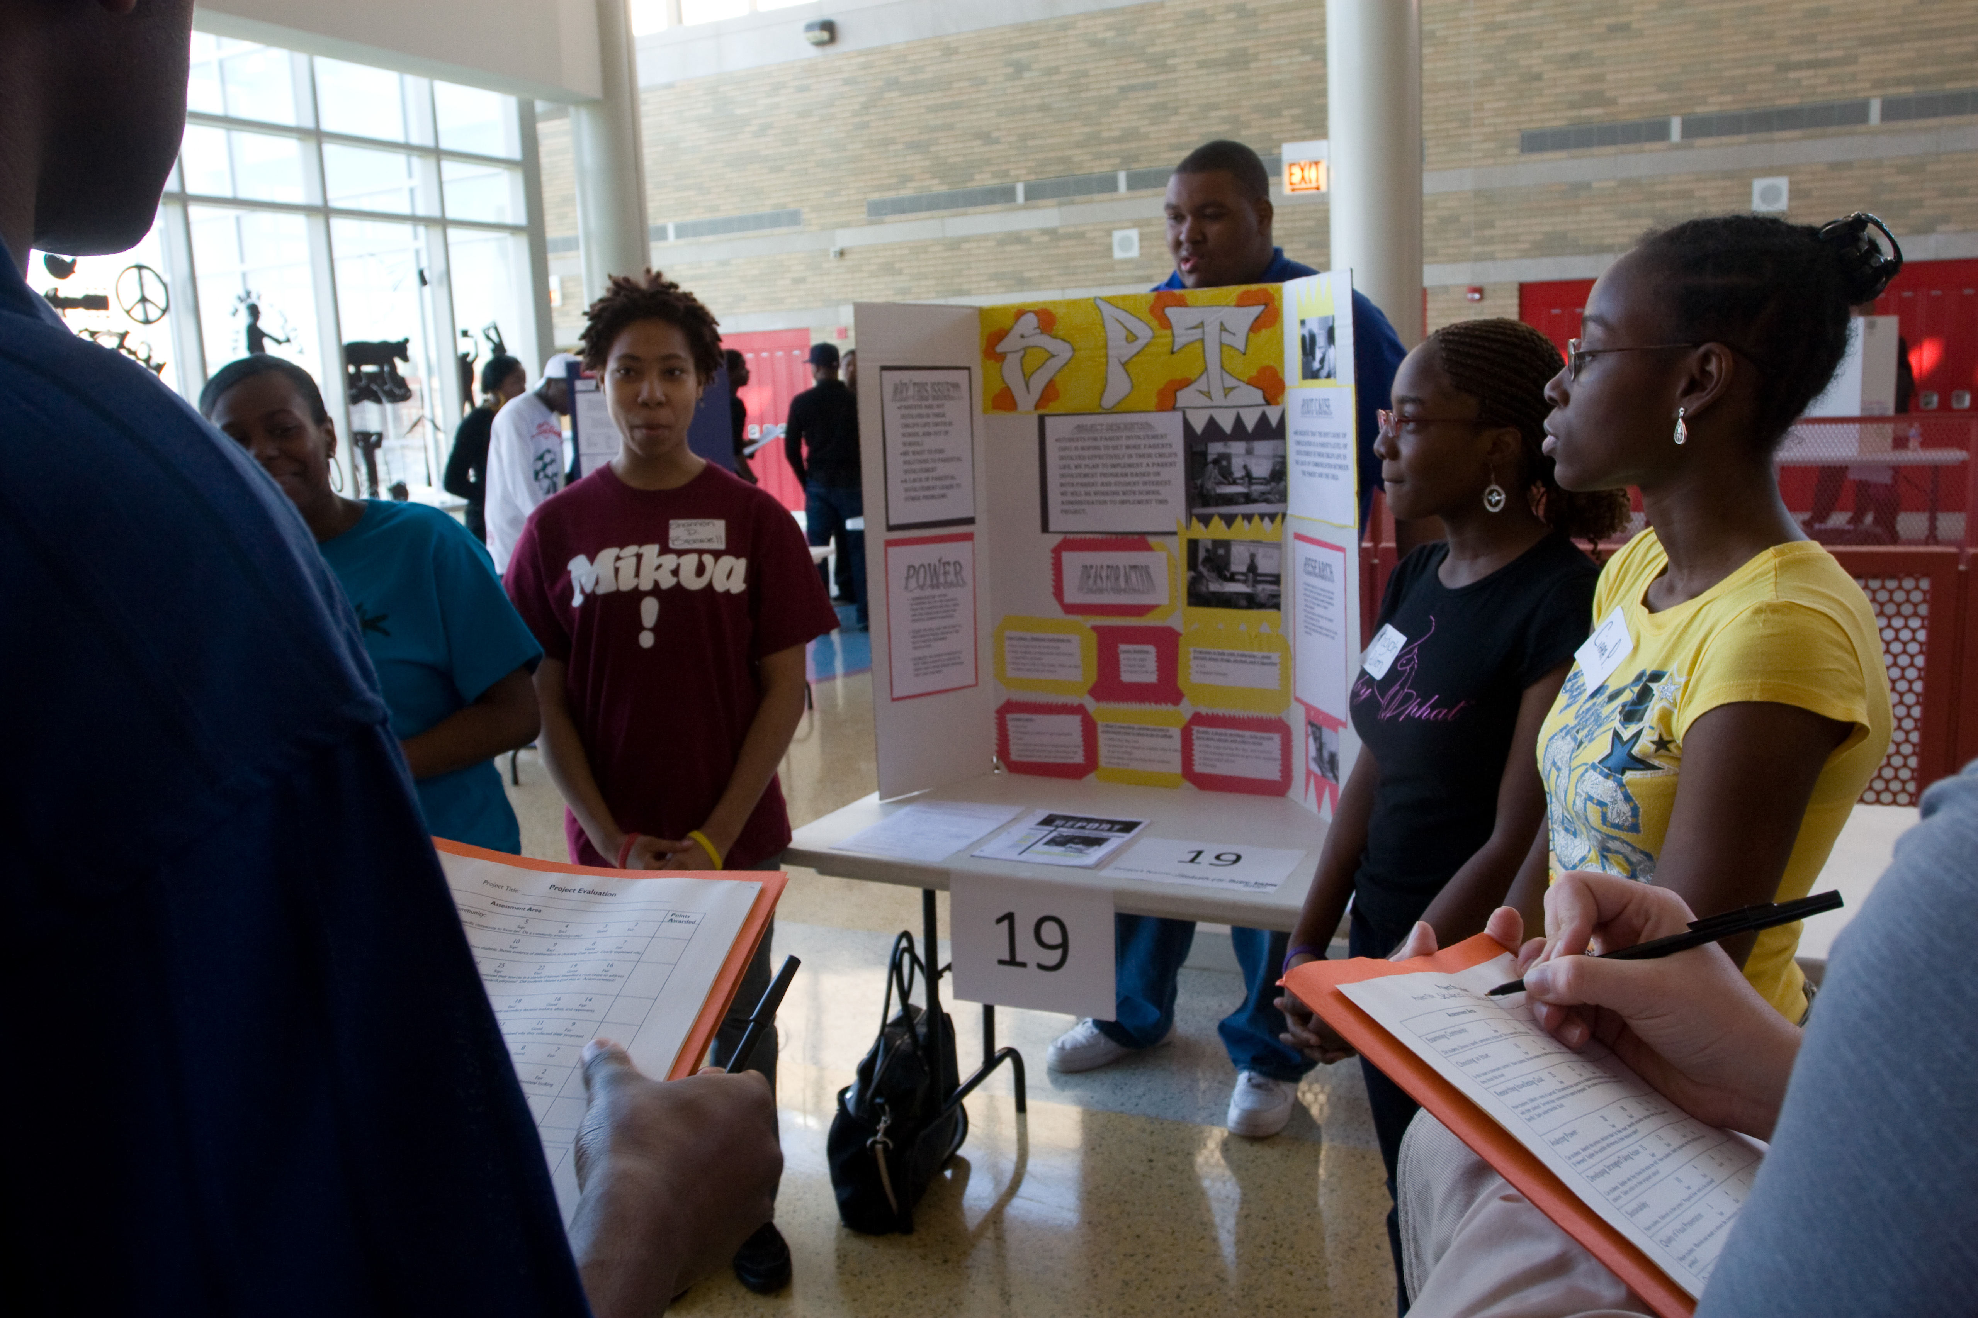

Slide 18
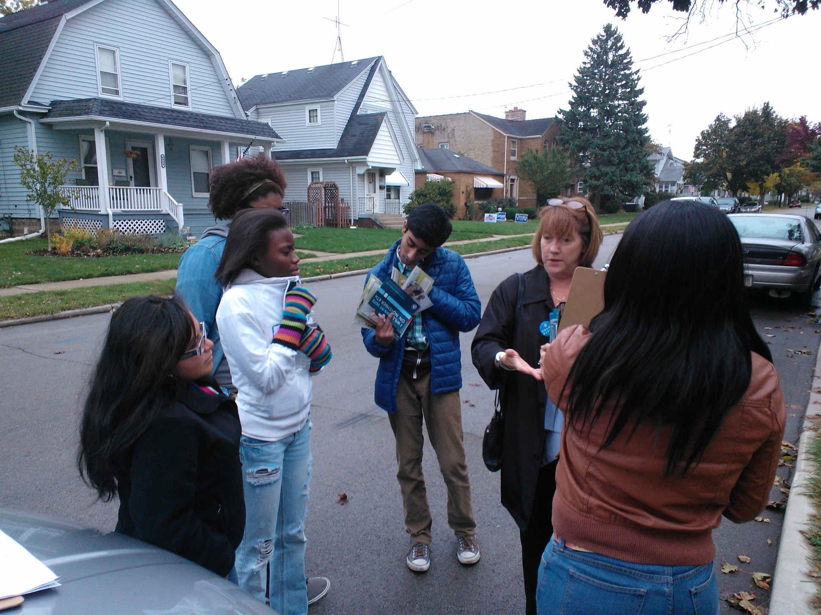

Slide 20
MIKVA ALUMNI
KEEP UP WITH THE NEWS
VOLUNTEER IN ELECTIONS
VOTE
3x
4x
16x
MORE THAN THEIR MILLENNIAL PEERS
Plus, they almost universally express enthusiasm
for running for school and college offices.
.

Slide 21
YOUNG ADULTS

Slide 22
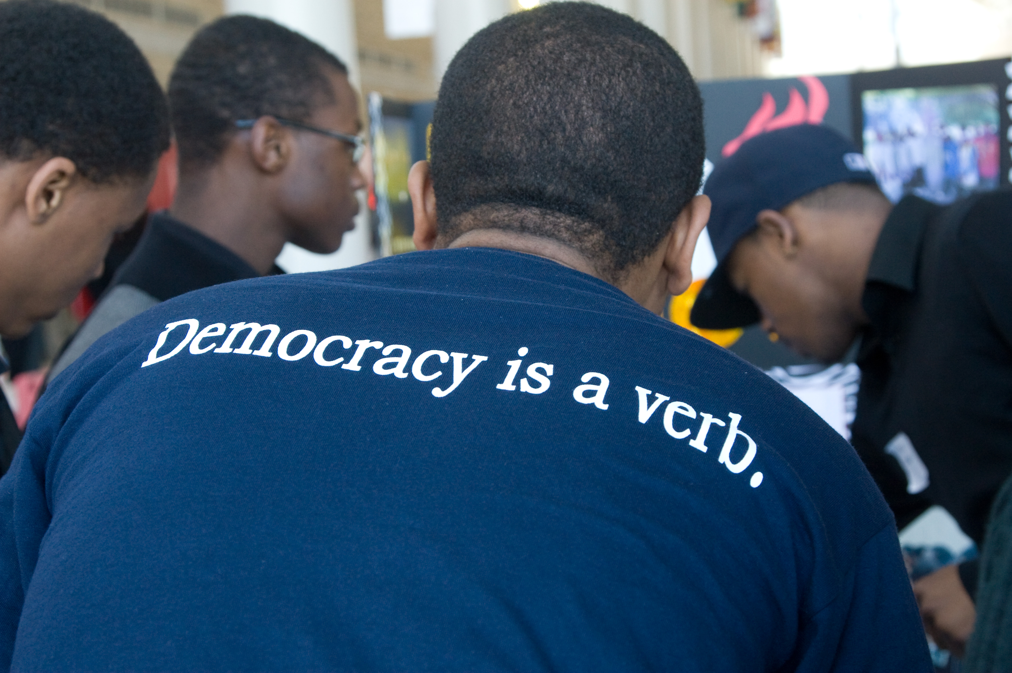
For More Information
brian@mikvachallenge.org
www.mikvachallenge.org

