Slide 1
Bridging Divides, Building Community
January 31st, 2017
www.nationalcivicleague.org/All-America-Conversations

Slide 2
Current Context
Talk of division and distrust can make it seem like we aren’t able to work together anymore.
Never been a more important time for cities and towns to stand up for the values that make communities strong: civility, humanity, trust, compassion, innovation and inclusion.
www.nationalcivicleague.org/All-America-Conversations

Slide 3
All-America Conversations:
Support the incredible work already taking place in many local communities.
All-America Conversations - explore local divides and identify specific actions to bridge those divides.
Opportunity to prove that we are still able to work together across dividing lines to create stronger, more equitable communities.
www.nationalcivicleague.org/All-America-Conversations

Slide 4
All-America Conversations:
Short, flexible conversations easily adapted to local circumstances.
Explore three main questions:
1. How can our community reflect the best of what we see in America?
2. What are the divisions in our community and how do they impact our ability to live in the kind of community we want?
3. How can we bridge these divisions?
www.nationalcivicleague.org/All-America-Conversations

Slide 5
Benefits
Engage with and learn from underrepresented groups
Reveal shared values between groups on different “sides” of key issues
Demonstrate that the city/nonprofit is committed to learning from and engaging residents
Surface previously unknown groups and leaders
Identify small, specific actions that remind people that we CAN work together across dividing lines
Part of national effort to address these issues
www.nationalcivicleague.org/All-America-Conversations

Slide 6
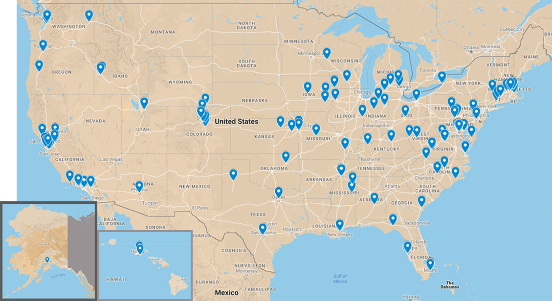
Toolkit downloads and webinar sign ups

Slide 7
Resources in the Toolkit
Determining what you want to learn (p3)
Whom to engage and tips for reaching underrepresented groups (p4-7)
Picking an engagement approach (p8-10)
Recruiting tips and a invitation template (p10-11)
Where to hold conversations (p12)
Facilitator and Note Taker resources (p13-19)
Setting up a conversation and what to ask (p20-24)
Making sense of what you heard and using it to take action. (p29-32)

Slide 8
Getting Started
What do you want to learn? (p3)
Focus on learning, not just getting quotes
Whom to engage? (p4-7)
Often requires talking to people we rarely engage
Tips for recruitment and engaging underrepresented groups (p5-6)
www.nationalcivicleague.org/All-America-Conversations

Slide 9
Picking an Engagement Approach
Ask yourself:
What approach best fits our learning goals and the groups we need to engage? This often means going beyond what’s easiest or most familiar.
Small Group Conversations
Large Open Meeting
Within an existing meeting

Slide 10
Small Group Approach
3 or more 90-min. small group (8-15 ppl) conversations held over time with different residents, in different locations.
Strengths
Best for learning about a specific group’s (particularly underrepresented groups) perspective
Best approach for reaching hard-to-engage populations
Learning and adjustment between conversations allows you to “refine” approach as you go
Limits
Participants may not get to engage with the full diversity of the community
Potentially harder to get media coverage – though the toolkit includes resources for partnering with media
www.nationalcivicleague.org/All-America-Conversations

Slide 11
Large Open Meeting (Town hall style)
Single large meeting where participants break up into multiple tables for simultaneous small group discussions
Strengths
Great for engaging many people in one evening
Potential for iconic, newsworthy event
Limits
Often less comfortable setting for many marginalized groups; could just be the usual suspects
Spreads facilitator and note taking resources thin
One-shot deal – cannot learn from mistakes over time
www.nationalcivicleague.org/All-America-Conversations

Slide 12
Within an Existing Meeting
Use 3 questions within an existing meeting or event
Strengths
Requires only 30 minutes
Limits
Unlikely to reach underrepresented groups
Limited time makes it hard to follow up and really delve into the questions
www.nationalcivicleague.org/All-America-Conversations

Slide 13
Setting Expectations
Set realistic expectations
Be honest about what can come from these
Then deliver on what you say will happen

Slide 14
Logistics Resources in the Toolkit
Recruitment strategies (p10)
Recruitment letter template (p11)
Good and not so good locations (p12)
www.nationalcivicleague.org/All-America-Conversations

Slide 15
Facilitators and Note Takers
Facilitators (p13-14)
Different skill set from running a meeting
What makes a good facilitator, where to find them locally and tips for leading conversations.
NCL may be able to help connect you to facilitators, or in some circumstances provide facilitation.
Note takers (p15-19)
Curious, good at listening for detail
Not about creating a transcript
Note taking tool organize notes and identify themes (p17-19)
www.nationalcivicleague.org/All-America-Conversations

Slide 16
Setting the stage for the conversation (p21)
Explain the purpose of the conversation
Describe the role of the facilitator
Introduce the note taker
Review ground rules
Set expectations
Encourage people to sign in to receive follow up communications

Slide 17
All-America Conversations: Questions
1. What would it look like if our community reflected what you want to see in America?
2. When people talk about things in the US today they say how divided we are – by race, religion, immigration, etc. What are the divisions we face here?
3. Thinking about what we’ve talked about, what would it take to bridge these divides?
www.nationalcivicleague.org/All-America-Conversations

Slide 18
What would it look like if our community reflected what you want to see in America?
Follow up questions
What differences do you see between the community you want and our community today?
What will it take to get to the community we want to become?
www.nationalcivicleague.org/All-America-Conversations

Slide 19
When people talk about things in the US today they say how divided we are – by race, religion, immigration, etc. What divisions do we face here?
Follow up questions
How do these divisions impact our community and our ability to create the community we want?
What is preventing us from bridging this divide and creating a more inclusive community?
What role, if any, has the city/nonprofit played creating or deepening these divides?
www.nationalcivicleague.org/All-America-Conversations

Slide 20
Thinking about what we’ve talked about: What would it take to bridge these divides?
Follow up questions
Where could we get started?
What common ground can we build upon?
What specific, small steps do you think could make a difference?
What role, if any, could the city or nonprofits play in helping us work together?
www.nationalcivicleague.org/All-America-Conversations

Slide 21
Thinking about what we’ve talked about: What would it take to bridge these divides?
Follow up questions
If things were getting better what would you see, how would you know things were improving?
What would give you confidence that, as a community, we were making progress?
What people or groups, would you trust to take action on the kinds of challenges we’ve talked about tonight?
www.nationalcivicleague.org/All-America-Conversations

Slide 22
Making sense of what you heard and using it
Organize your notes
Identify initial themes
What are people trying to tell us?
Create and test a story that pulls together different themes and insights
Ask yourself what did we learn?
Identify how you will use what you learned
Follow up with participants

Slide 23
F.A.C. Frequent Anxieties and Concerns
We’ve already had conversations like this
How can you leverage that experience to reach out further or more deeply engage hard-to-reach groups
We’ve tried to engage XYZ, it never works
It is hard, but it is essential that we understand the lives and challenges of those we serve. Toolkit may offer new ideas for reaching these groups
People will be upset and emotional
That’s a sign we’re hitting on meaningful topics.
These never go anywhere – nothing happens
Given our duty to those we serve, we cannot afford to give up. Set reasonable expectations – ones that you can deliver upon. Build momentum as you go.
www.nationalcivicleague.org/All-America-Conversations

Slide 24
Questions
What would be helpful for you to get started?
What support can we provide?
www.nationalcivicleague.org/All-America-Conversations

Slide 25
Moving Forward
Visit www.nationalcivicleague.org/All-America-Conversations for additional resources and updates.
Let us know when you hold a conversation and we’ll put your community our map.
Please encourage others in your community and region to hold these conversations as well.
We want to hold additional calls to provide coaching, support and to learn from you. Stay tuned for details.
If you have questions, comments, concerns or suggestions please email: aaronl@ncl.org
www.nationalcivicleague.org/All-America-Conversations

Slide 26
National Civic League
Founded in 1894 by Teddy Roosevelt and other reformers
Works to create inclusive, thriving communities by inspiring, supporting and recognizing equitable approaches to community decision-making.
Additional Resources/ Opportunities for those holding All-America Conversations
All-America City Award
Racial Healing and Racial Equity
Community Assistance
National Civic Review
www.nationalcivicleague.org/All-America-Conversations

Slide 27
Bridging Divides, Building Community
January 31st, 2017
www.nationalcivicleague.org/All-America-Conversations

